Slide 1
Research Methods
CSCI 4108
Summer 2024
Lesson 2: the proposal
Prepared by: Dr. Rebhi Baraka
Updated by: Dr. Motaz Saad
Faculty of Information Technology
Islamic University of Gaza

Slide 2
The proposal
Importance of the proposal
Structure of the proposal

Slide 3
Importance of the proposal
To provide a plan for your project.
It serves as your communication to your advisor
It is a requirement to approve to pursue your graduation project.
It serves as an agreement between you and your advisor
The contents of the proposal becomes your plan of action and outline of work to be done throughout the project.
The contents of the proposal becomes a part of the graduation project report.

Slide 4
Structure of the proposal
Title page
Table of contents
Abstract
Introduction
Statement of the problem
Objectives
Importance of the project
Scope and limitations of the project
Methodology
Tools, equipment and methods
Time Table
Related Works
Bibliography (References)
You should follow the template

Slide 5
Structure of the proposal
Title page
Table of contents
Abstract
Introduction
Statement of the problem
Objectives
Importance of the project
Scope and limitations of the project
Methodology
Tools, equipment and methods
Time Table
Related Works
Bibliography (References)

Slide 6
Title page
The cover page of your proposal.
It includes the title of your project.
The title should be indicative

Slide 7
Structure of the proposal
Title page
Table of contents
Abstract
Introduction
Statement of the problem
Objectives
Importance of the project
Scope and limitations of the project
Methodology
Tools, equipment and methods
Time Table
Related Works
Bibliography (References)

Slide 8
Table of contents (ToC)
A list of the sections and sub-sections of the report,
A list of figures/tables and Appendices
Tip: use styles and formatting to automatically generate the ToC after you finish writing

Slide 9
Structure of the proposal
Title page
Table of contents
Abstract
Introduction
Statement of the problem
Objectives
Importance of the project
Scope and limitations of the project
Methodology
Tools, equipment and methods
Time Table
Related Works
Bibliography (References)

Slide 10
Abstract
A short paragraph summarizing the main contents of the proposal.
It should include a short statement of:
  what your project is all about,
  what are you going to accomplish in the project (objectives)
  importance of your project proposal.
The abstract (summary) should be concise, informative and independent of the report.
Write the abstract after you have written the report.

Slide 11
Order of typical elements included in the abstract (BPMRC)
B = Background information
P = The Principle activity (or Purpose) of the study and its scope
M = Methodology used in the study
R = The most important Results of the study
C = A statement of Conclusion or recommendation

Slide 12
Abstract example
Utility programs has benefits for end users. The aim of this project is to develop a utility program (pdf-shuffler) that help end users to reorder the pages of a given pdf document. We use Agile software process model to develop the pdf-shuffler. The proposed utility make ordering pdf pages very easy to end users. Pdf-shuffler is very useful and handy tool for end user.
Background (green)
purpose / principle activity (blue)
Methodology (red)
result (orange)
Conclusion (gray)

Slide 13
Structure of the proposal
Title page
Table of contents
Abstract
Introduction
Statement of the problem
Objectives
Importance of the project
Scope and limitations of the project
Methodology
Tools, equipments and methods
Time Table
Related Works
Bibliography (References)

Slide 14
Introduction
It should give a brief general background to the subject area of the report
Indicate the proposed development.
Provide the context and scope of the proposal and should include your terms of reference.
Informally state your objectives, define the limits of the report, outline the method of the work

Slide 15
A big picture for
article structures:
AIMRaD (Abstract, Introduction, Methods, Results, and Discussion)

Slide 16
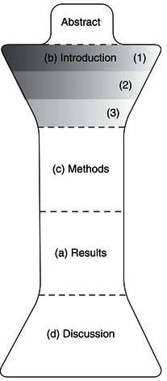

Slide 17
A big picture for
Proposal structures:
Abstract,
Introduction,
Problem statement,
objectives, scope and limitations, Methodology,
related works

Slide 19
6
abstract
4
Introduction
1,3
Problem statement / Motivation / Importance / scope and limitations
5
Methodology, time table, tools, equipments
2
Related works / literature review

Slide 20

Introduction

Slide 21
Introduction
p1
p2
p3
p1: the introduction begins with broad focus.
You should attract the attention and the interest of the reader.
p2: between B1 and B2 background information and previous works are connected here together to logically connect previous work with the problem that you address in your project
p3: the introduction ends with exactly one point (the result of the project). Usually it is a statement of purpose / aim of the work.

Slide 22
Introduction Example

Slide 23
Computers are used nowadays every where in our life. They are used in many applications such as business, medicine, education, and so many other domains. (p1)
PDF documents are widely used as a standard electronic document format because it preserve the formatting. PDF utilities are handy tools that help end users to process their documents, in addition, it is widely used. (p1)
There are many pdf utilities available in the app store such as tools that convert documents into pdf format, and tools that combines pdf files. (p2)
The application XX provides functionality to convert files from various formats (doc, ppt, xls, jpg) into pdf format. (p2)
The application YY provides functionality to combine pdf documents into one file. (p2)
However, these tools does not provide functionality to manipulate the order of pages of a given pdf document. (p2)
The aim of this project is to develop a desktop application that provides functionality to manipulate the order of pages in a pdf document. We call this application as “pdf shuffler”. (p3)

Slide 24
Another introduction Example

Slide 25
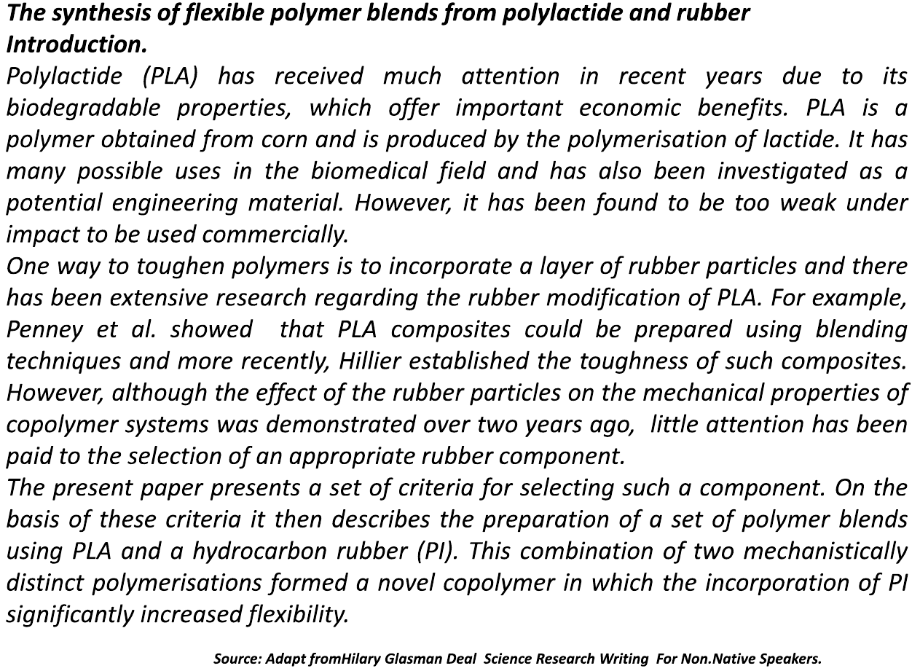

Slide 26
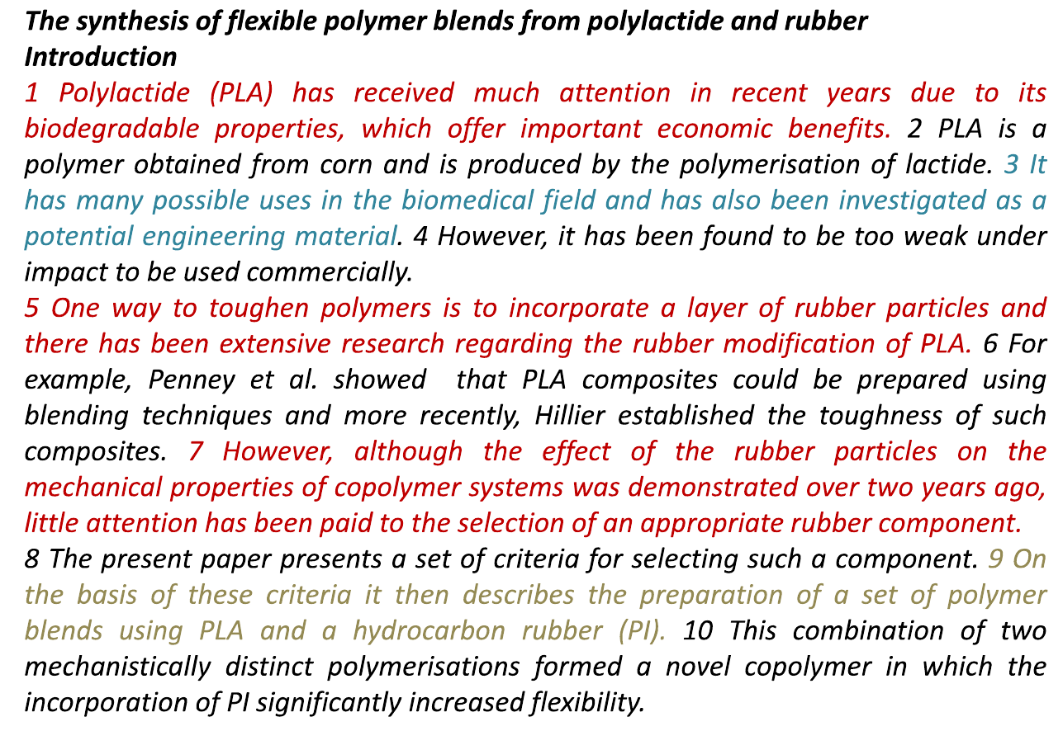

Slide 27
the writer establishes the importance of this research topic
the writer provides general background information
the writer does the same as in S1 and S2 but in a more specific/detailed way
the writer describes general problem area or current research focus of the field
the writer provides a transition between general problem area and literature review
the writer provides a brief overview of key research projects in this area
the writer describes a gap in the research
the writer describes the work itself
the writer gives details about the methodology reported in the project
the writer announces the findings

Slide 28
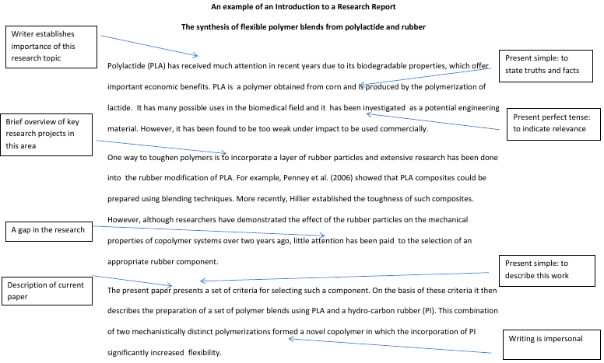

Slide 29
Introduction FAQs
Q: How many pages should I write in the introduction?
A: There is no concrete answer. It depends.

Slide 30
Structure of the proposal
Title page
Table of contents
Abstract
Introduction
Statement of the problem
Objectives
Importance of the project
Scope and limitations of the project
Methodology
Tools, equipments and methods
Time Table
State of the art / literature review / related works
Bibliography (References)

Slide 31
Statement of the problem

Slide 32
Statement of the problem
The heart of the project is the problem
It is important to articulate an acceptable problem
It should be well written and clearly stated

Slide 33
Structure of the proposal
Title page
Table of contents
Abstract
Introduction
Statement of the problem
Objectives
Importance of the project
Scope and limitations of the project
Methodology
Tools, equipments and methods
Time Table
Related Works
Bibliography (References)

Slide 34

Objectives

Slide 35
Objectives
Think about how you are going to achieve the solution to your project problem, think in terms of sub-goals (objectives) that will lead you towards the solution of the problem.
By fulfilling each of the objectives you should reach the solution.
Each objective is a small, achievable and assessable unit, i.e. a sub-goal of the project.
Objectives should be formulated in such a way that fulfilling the objectives leads to the overall aim being satisfied.

Slide 36
Structure of the proposal
Title page
Table of contents
Abstract
Introduction
Statement of the problem
Objectives
Importance of the project
Scope and limitations of the project
Methodology
Tools, equipments and methods
Time Table
Related Works
Bibliography (References)

Slide 37
Importance of the project
What is the application / impact of your project?
What practical value does the project have?
What good is the project?

Slide 38
Structure of the proposal
Title page
Table of contents
Abstract
Introduction
Statement of the problem
Objectives
Importance of the project
Scope and limitations of the project
Methodology
Tools, equipments and methods
Time Table
Related Works
Bibliography (References)

Slide 39
Scope and limitations of the project
Delimit the research
  What you intend to do and do not intend to do
State the assumptions
  Offer a clear statement of all assumptions upon which the project will rest
Define the terms
  Give the meaning of all terms in the problem and subproblems that have any possibility of being misunderstood.

Slide 40
Scope vs Limitation
The difference between scope and limitation is
  The scope is the breadth, depth or reach of a subject; a domain.
  The App/Film targets children aged 8-12 years old.
  Limitation
    The act of limiting or the state of being limited.
    A restriction; a boundary, real or metaphorical, caused by some thing or some circumstance.
    The bounds, are influences that you cannot control. They are the shortcomings, conditions.
    Example: The app requires high speed Internet connection but we have 2G network!

Slide 41
Structure of the proposal
Title page
Table of contents
Abstract
Introduction
Statement of the problem
Objectives
Importance of the project
Scope and limitations of the project
Methodology
Tools, equipments and methods
Time Table
State of the art / literature review / related works
Bibliography (References)

Slide 42

Methodology

Slide 43
Methodology
State how you will carry out your project. Could be the following:
  How will you collect your data?
  Will you carry out interviews or questionnaires, What measurements will you make?
  What software methodology will you use? What programming methodology will you use?

Slide 44
Structure of the proposal
Title page
Table of contents
Abstract
Introduction
Statement of the problem
Objectives
Importance of the project
Scope and limitations of the project
Methodology
Tools, equipments and methods
Time Table
Related Works
Bibliography (References)

Slide 45

Tools and equipments

Slide 46
Tools, equipment and methods
Software tools, packages, APIs, software libraries, special environments, frameworks, etc. that are necessary to carry out the project.
Any special equipment, devices, hardware, etc. need for the project.
Any existing method such as software methods, algorithms, approaches that are needed in the project.

Slide 47
Structure of the proposal
Title page
Table of contents
Abstract
Introduction
Statement of the problem
Objectives
Importance of the project
Scope and limitations of the project
Methodology
Tools, equipments and methods
Time Table
Related Works
Bibliography (References)

Slide 48
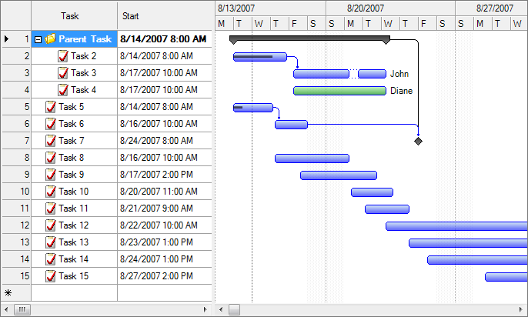
Time table

Slide 49
Time Table
Project breakdown: Decompose your project into tasks, define the dependency between tasks and estimate the required time for each task.
  Dates for submission of drafts, final versions.
  Dates for completion of phases or objectives
  ….
The difficult part with developing a time plan is to accurately estimate the time required for each activity. Thus, it is important that you continuously update your

Slide 50
Structure of the proposal
Title page
Table of contents
Abstract
Introduction
Statement of the problem
Objectives
Importance of the project
Scope and limitations of the project
Methodology
Tools, equipments and methods
Time Table
Related Works
Bibliography (References)

Slide 51
Structure of the proposal
Title page
Table of contents
Abstract
Introduction
Statement of the problem
Objectives
Importance of the project
Scope and limitations of the project
Methodology
Tools, equipments and methods
Time Table
Related Works
Bibliography (References)

Slide 52

Related words

Slide 53
State of the art / literature review / related works
Find works similar to your works and review them.
Positioning your work in the context of other people’s work in the area.
To reveal sources of data not known to you
To attack the problem
To see your work in historical and field perspective
To provide you with new ideas and approaches
Review the work do not reproduce it.

Slide 54
State of the art / literature review / related works
You should show how your work is different from other similar works.
  Main differences could be
    In the problem
    Same problem but different approach / methodology
    In the deliverables

Slide 55
Review related works
Visit the library
Use online resources
Be selective
Keep up to date (continuous review)

Slide 56
How to select the literature
Read the title and decide if it is pertinent or not.
If not, read the abstract and decide whether to read the entire article or not.
If not clear, read some parts of the article to decide if it is pertinent or not.

Slide 57
Related works FAQs
Q: How many related work should I review?
A: there is no concrete answer. You should continue to review literature until you feel that you reviewed all related works
Q: How many details should I cover in the review?
A: The project idea, the functionalities, the methodology, the result / impact. Each review should not exceeds one half page.

Slide 58
Structure of the proposal
Title page
Table of contents
Abstract
Introduction
Statement of the problem
Objectives
Importance of the project
Scope and limitations of the project
Methodology
Tools, equipments and methods
Time Table
Related Works
Bibliography (References)

Slide 59
Bibliography (References)
A reference is a description that identifies an information source.
Example: citing a journal article written by K. Anderson:
  Anderson, K. (2008). The Untold Story of Computer Science. International Journal of Computer Science, 2(1), 23–35.1
Citation is import because you:
  Show how your work extends the current state-of-the-art knowledge
  Show the originality of your work
  Give credit to other people’s work (and thereby avoid being accused of plagiarism)
  Support and validate arguments made in your report
  Show that you are familiar with the work done in the area
References cab be:
  Books, previous student projects, journals, conference and workshop proceedings, theses, magazines, Web pages, newspapers, and other documents such as manuals, etc.
You should follow a citation style: (Chicago, MLA, ASC, ….).
  You can use on-line tools such as www.easybib.com

Slide 60
Writing
Write simple English
Make your the structure is correct (SVO)
Use spell checker
Make good transition between paragraphs
Make the reader enjoy reading
Please read what your write before submitting
Good writing style can not be taught, but rather requires a lot of practice

Slide 61
Style
Write in the “we” rather than “I” form, and use the present tense (e.g. “We calculate the premiums under those assumptions”).
Avoid direct quotes unless absolutely essential. Instead, you should paraphrase what others have said, but still reference them.
Avoid “n’t” and “it’s” as they are examples of how we talk, but not how we write in formal terms – e.g. write “cannot” and “it is” in full.
Use simple present tense in the proposal. You can only use past tens when you review for the related works.

Slide 62
Formatting
It is recommended to use automatic formatting
Do not forget the captions for tables and figures.
Do not forget to refer to tables and figures in the text.
Always introduce a figure/table in the text before it appears (i.e. leave no surprises for the reader).

Slide 63
End of slides

